Slide 1
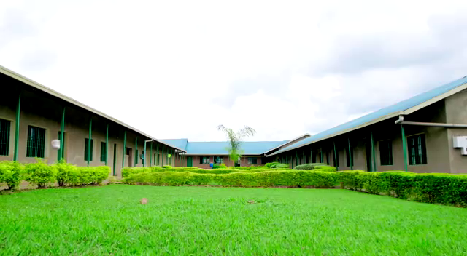

TOPIC: ST.PHILIP online MANAGEMENT SYSTEM
PRESENTATION :
NDAYISHIMIYE Muhamudu
Case Study: ST.PHILIP TVET SCHOOL
In Senior Six Computer Science Option
Notes:
HEADING

Slide 2

CHAP 1. GENERAL INTRODUCTION

Slide 3

General Introduction
St. Philip TVET School is the school of Catholics that has four options such as Computer science, Hotel Operations, Accountancy and Tourism.
It is a technical school that is included in WDA(Workforce Development Authority).
This school is located in Kigali city, Kicukiro district, Nyarungege sector

Slide 4
Problem statement and Solutions
Problem statement
There was no easy communication of parents with school staff / administrator or management of the school due to:
Lack of security and integrity of the school assessment reports.
Time consume to get student card
Student information is stored manually
Solution of the problems
The solution of the mentioned problems above is to creation of web application that manages the school.
This site will reduce time consuming by generating student information easier, generating automatic assessment reports and school cards etc…

Slide 5
General and Specific objectives
General Objectives
The general objectives of this web application is to act as an online brochure for prospective
Students and parents, providing them with much information about the school and improve the efficiency and effectiveness of communication between students, parents, teachers and school administration.
Specific Objectives
The specific objectives of this project are:
To manage all school tasks done in the school.
To get information of the students easily
Automatic Assessment student report and school card.
Storing school data for long time and well secured with backup.

Slide 6
CHAP 2. LITERATURE REVIEW
This chapter explains related theoretical work or references used to develop the “ST. PHILIP TVET ONLINE MANAGEMENT SYSTEM“ and a background of the web application.

Slide 7
CHAP 3. RESEACH METHODOLOGY

Slide 8
Methodology of the system
The methodologies used to achieve the objective of this project is:
Data collection techniques where by I used the following techniques:
Observation
Interview
Documentation

Slide 9
CHAP 4. DESIGN AND IMPLEMENTATION
This chapter is focused on the implementation of the system

Slide 10
CHAP 5. CONCLUSION & RECOMMENDATION

Slide 11
Conclusion
During the realization of my project I used all possible solution to analyze a system that will act as an online brochure for prospective administrator, student and parents as much information as possible to help them decide if the school is right for them.
I also conclude that this system provide an automated assessment student report and the work will be more easier for both staff and administrators

Slide 12
Recommendation
During the development of this project I met some problems, that’s why I recommend that:
The school might provide all needed materials in project researches like books, done projects and other documents as reference for students and give them more time in their research.

Slide 13
Thank you

